Slide 1
Small Business Works 2022:
Navigating Equity in Procurement
U.S. General Services Administration

Slide 2
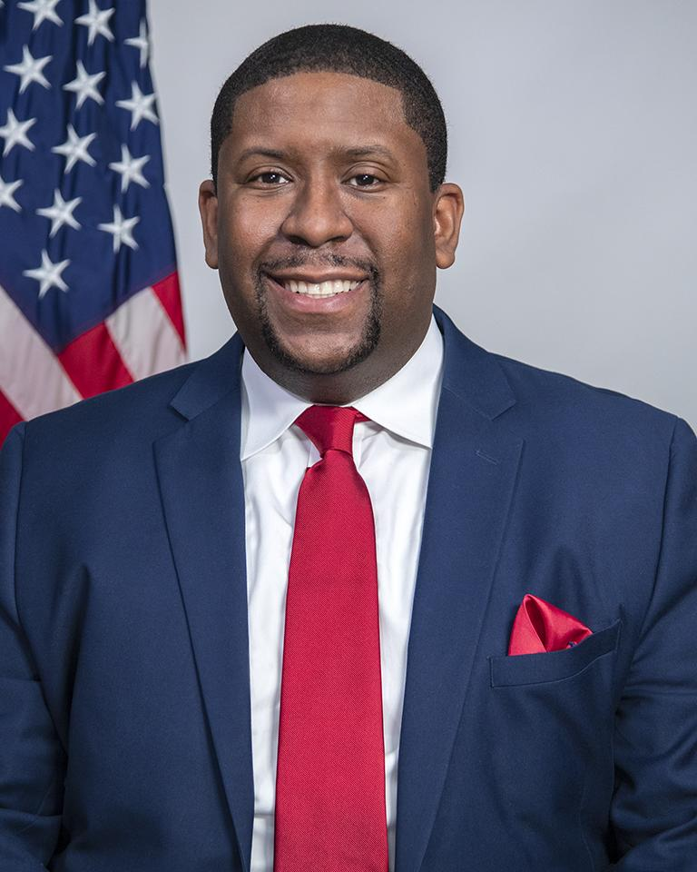
Welcoming Remarks
Exodie C. Roe, III
Associate Administrator
Office of Small and Disadvantaged Business Utilization
U.S. General Services Administration

Slide 3
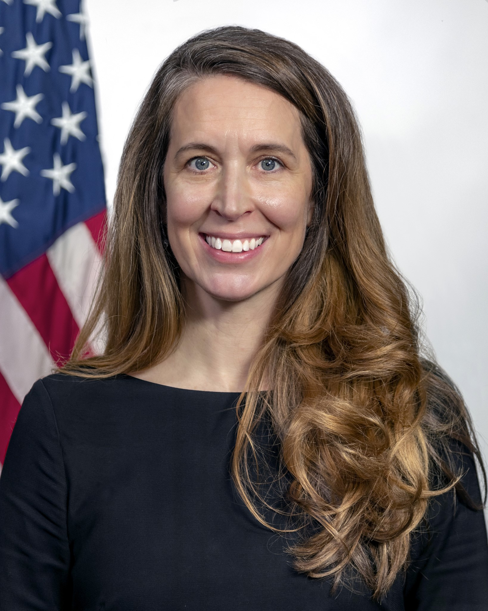
Opening Remarks
Katy Kale
Deputy Administrator
U.S. General Services Administration

Slide 4
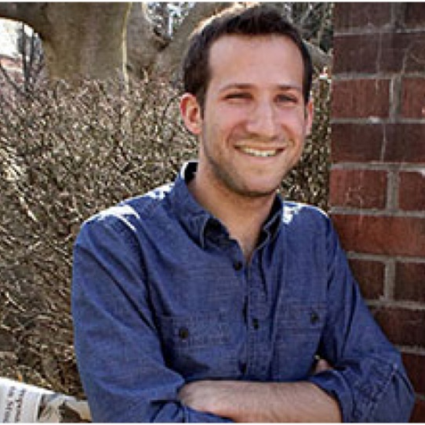
Keynote Address
Chad Maisel
Director of Racial and Economic Justice
White House Domestic Policy Council

Slide 5
Concurrent Educational Sessions

