Slide 1
Small Business Works 2022:
Navigating Equity in Procurement
U.S. General Services Administration

Slide 2
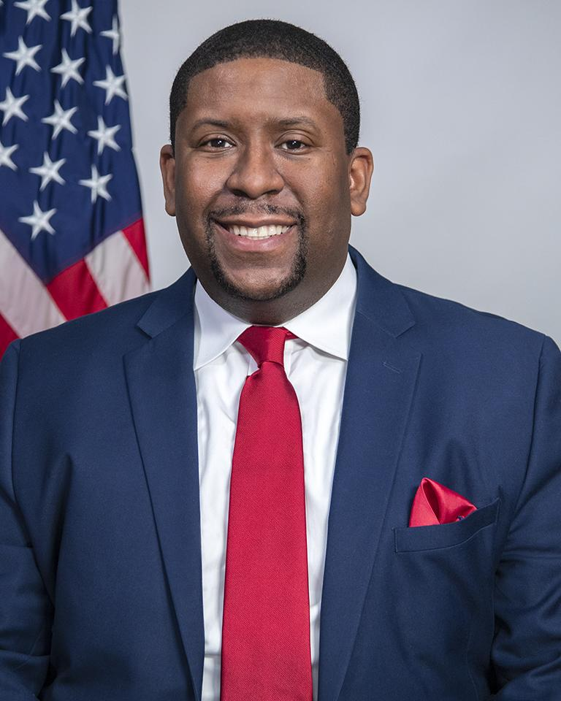
Welcoming Remarks
Exodie C. Roe, III
Associate Administrator
Office of Small and Disadvantaged Business Utilization
U.S. General Services Administration

Slide 3
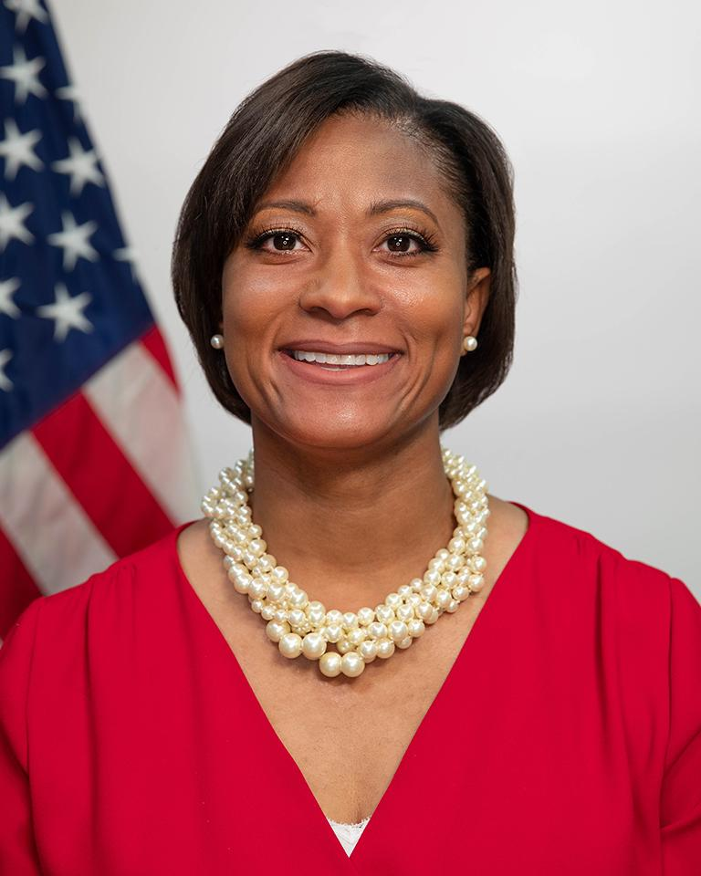
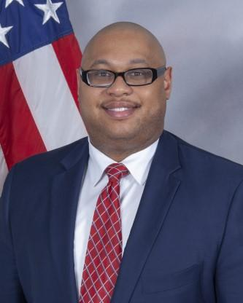
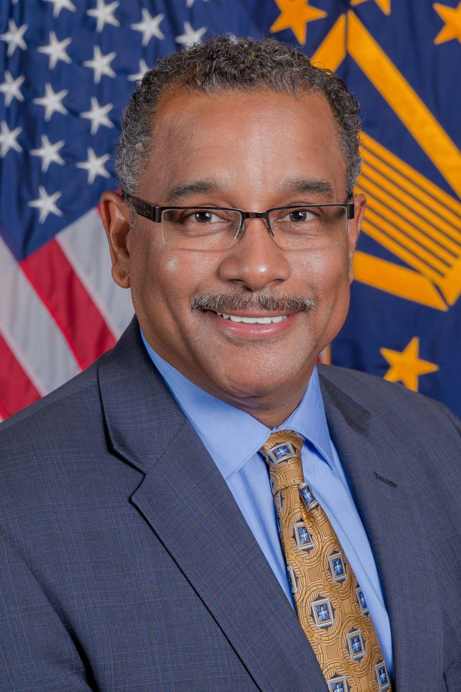
Fireside Chat Panel
Krystal Brumfield
Associate Administrator and
Chief Acquisition Officer
Office of Governmentwide Policy
U.S. General Services Administration
Antonio Doss
Deputy Associate Administrator
Office of Government Contracting and Business Development
U.S. Small Business Administration
Dwight D. Deneal
Director
Office of Small Business Programs
U.S. Defense Logistics Agency

Slide 4
Question 1
Equity in Procurement:
What does equity in procurement mean to you and your agency?

Slide 5
Question 2
Equity in Procurement:
What would reflect true equity in procurement?

Slide 6
Question 3
Acquisition Workforce:
What can the Federal acquisition workforce do to contribute to these efforts?

Slide 7
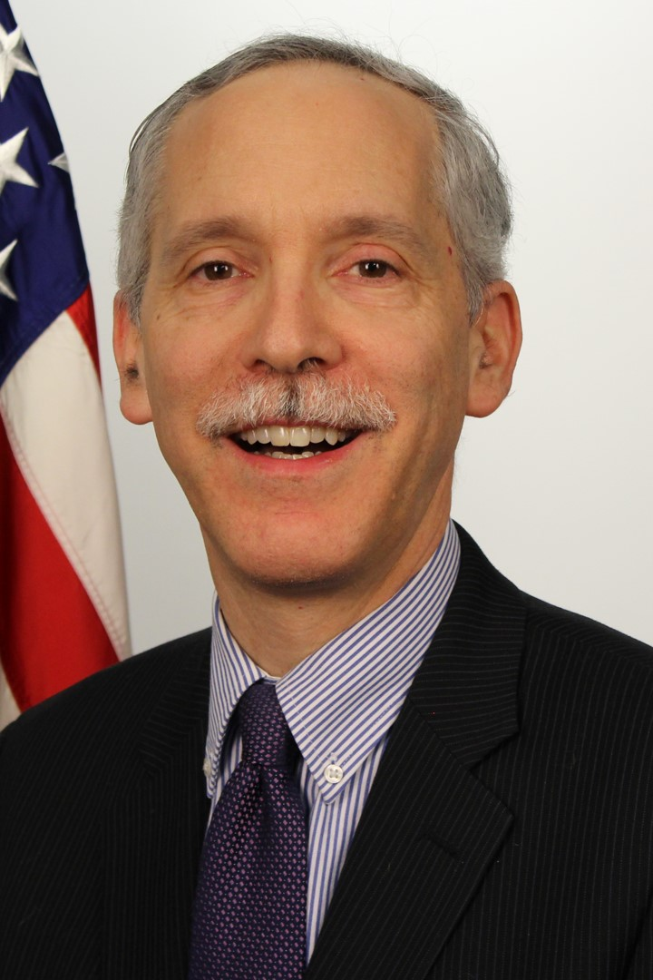
Keynote Address
Mathew Blum
Acting Administrator
Office of Federal Procurement Policy
Office of Management and Budget

Slide 8
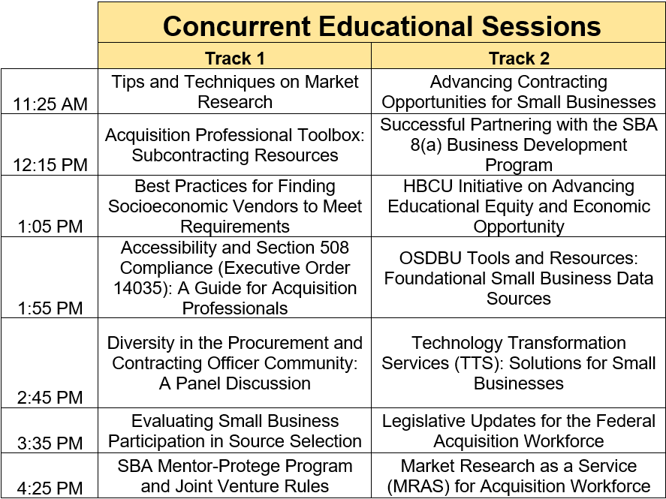
8

