Slide 1
Small Business Works 2022:
Success Leaves Clues: Learn Best Practices from Successful Socioeconomic Small Businesses: Panel Discussion
Day 1: July 26, 2022
U.S. General Services Administration

Slide 2
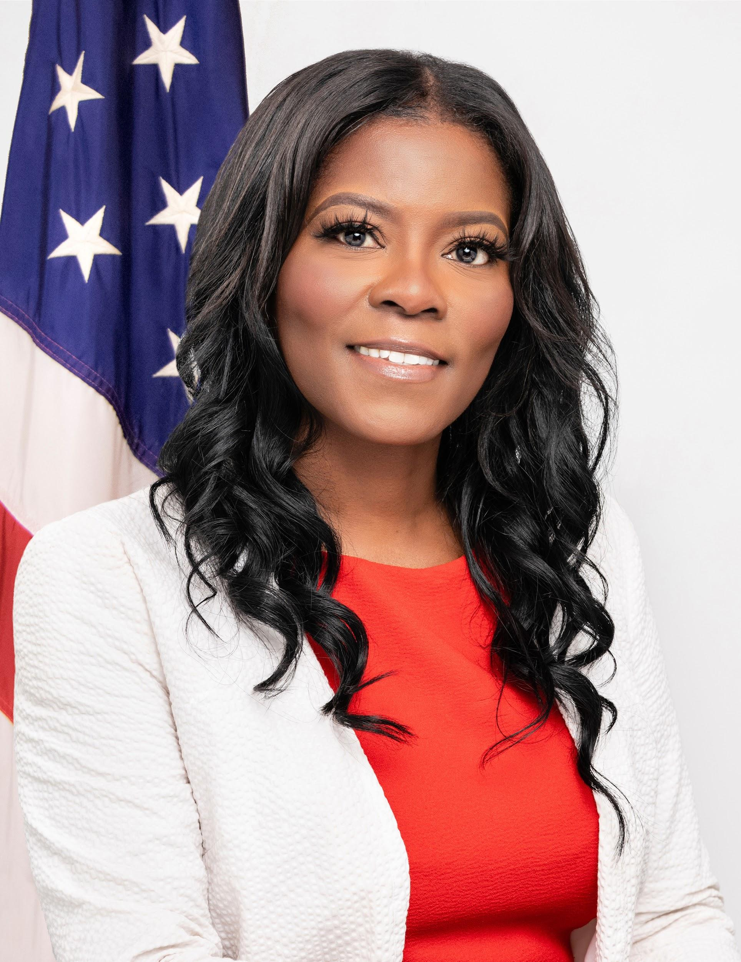
TODAY’S MODERATOR
Chasity Ash
Supervisory Small Business Technical Adviser
U.S. General Services Administration

Slide 3
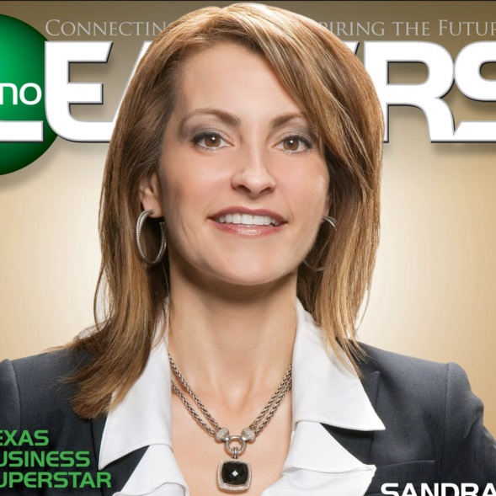
TODAY’S PANELISTS
MaryEllen Martin
CEO
P3S Corporation

Slide 4
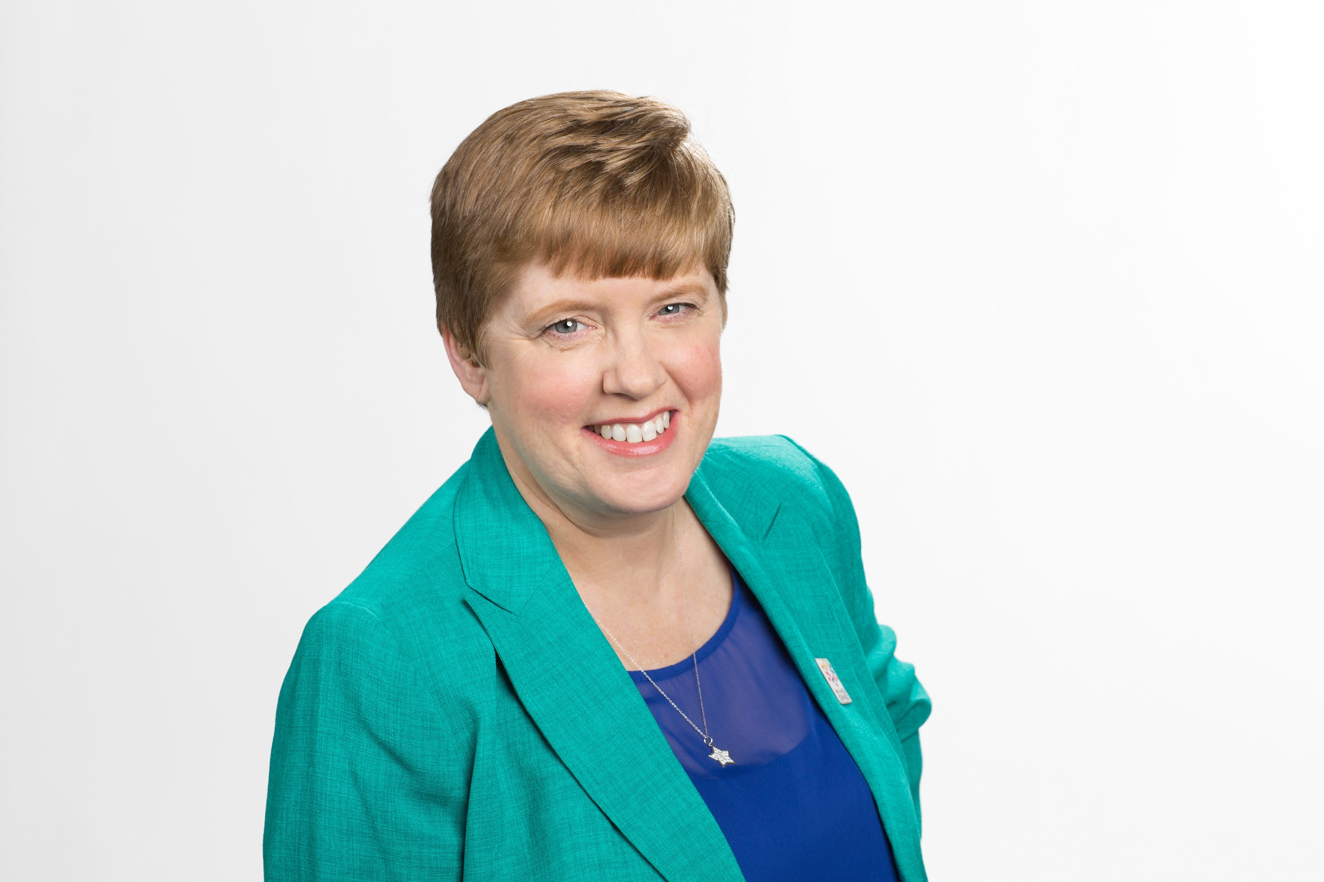
TODAY’S PANELISTS
Doreen Blades
President
US Eco Products Corporation

Slide 5
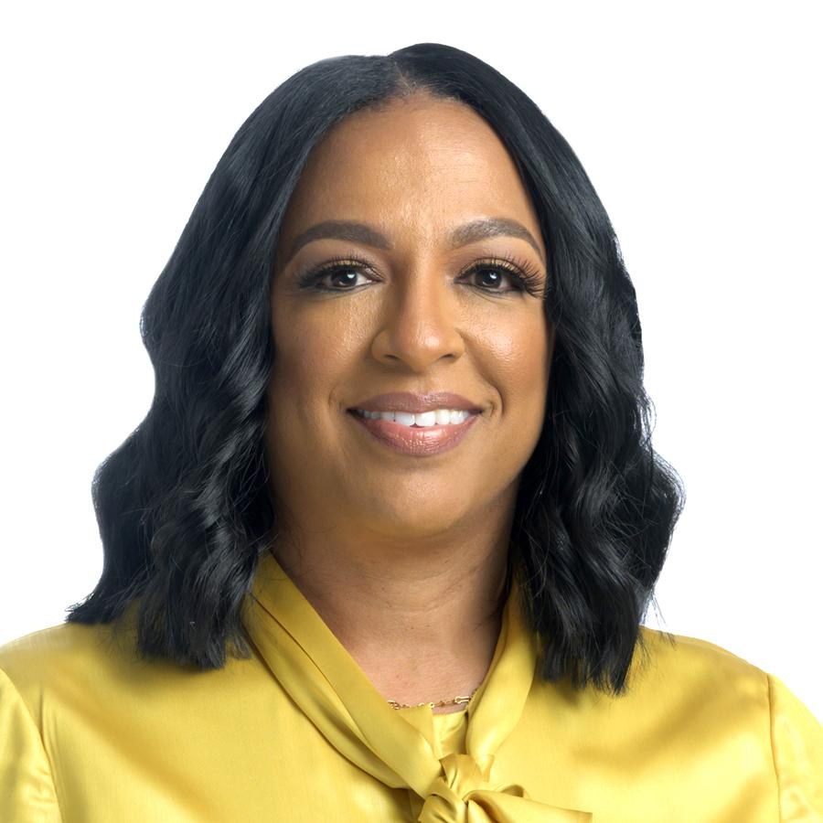
TODAY’S PANELISTS
Necole Parker
CEO
Elocen Group

Slide 6
Question 1
Can you please share some of the pitfalls and pearls you’ve learned along the way that have helped your success or added to your best practices in doing business with the federal government?

Slide 7
Question 2
How did you gained working capital before the pandemic as compared to managing it during the crisis and in our current COVID-19 situation?

Slide 8
Question 3
How are you marketing your schedule/or company (non-schedule holders) to the Federal Government? What plan of action do you have in place?

Slide 9
Final Thoughts

Slide 10
Questions?

Slide 11
Thank You!

