Slide 1
Small Business Works 2022:
Navigating Equity in Procurement
U.S. General Services Administration

Slide 2
Effective and Successful Proposal Writing Techniques for Small Businesses
Nancy C. Cleveland
Procurement and Veterans Affairs Certified Verification Counselor
Georgia Tech Procurement Assistance Centers (GTPAC)

Slide 3
What We’ll Cover:
GTPAC – Who We Are and What We Do
The Acquisition Process
Difference between RFPs and IFBs
Proposal Writing Preliminaries
Read, Understand, Plan, Prepare
Think about who will read your proposal.
Bringing It All Together
Keys to Successful Written Proposals
Proposals Lose Points

Slide 4
Determine Your Suitability for Government Contracting
GTPAC – Who We Are & What We Do
Teaches Georgia-based businesses how to navigate the government procurement processes, identify opportunities, prepare to compete for and win contracts
Seminars, Webinars, Workshops, Small Group Round Tables, Industry Days and Outreach Programs
Government Marketplace poses unique challenges:
It can overwhelm or ruin a company based on the maturity or resources it may take to meet the challenges.
No Charge to You
www.gtpac.org
GTPAC Clients receive additional benefits: One-on-one Counseling
Bid Match Account

Slide 5
The
Entire Acquisition
Process
Requirements
Market
Research
Closeout
Administration
Solicitation Preparation
Award
Proposal
Evaluation
* YOUR BID or PROPOSAL*

Slide 6
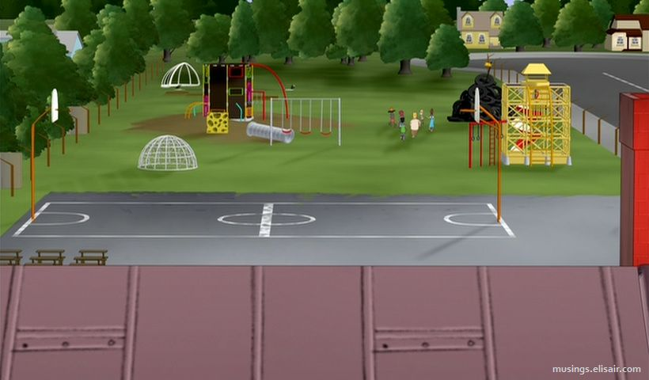
Mandatory Registrations to Play on the Federal Acquisition Playground
SAM.gov
eVerify
Buyers’ Supplier Databases

Slide 7
Definitions of 4 Often Referred to Solicitations by Government
Solicitation – An advertised invitation to submit a bid, a quote, or a proposal to fulfill a requirement of the government. Sometimes referred to as an IFB, RFQ or RFP.
Presolicitation – Summary of a forthcoming solicitation, not yet ready for a formal bid. Usually issued at least 15 days before the Solicitation. During the pre-solicitation period, vendors normally are at liberty to pose questions and offer suggestions and information.

Slide 8
Definitions of 4 Often Referred to Solicitations by Government (con’t)
Combined Synopsis/Solicitation – A streamlined solicitation for commercial items which solicits proposals
Sources Sought – A published synopsis to determine interest in each acquisition. It requests interested parties to submit their capabilities to determine their ability to perform.
Often used to determine whether a set-aside to small businesses can be justified.

Slide 9
Decoding the Solicitation
Difference between Bids and Proposals
BIDS | PROPOSALS
Bids are submitted in response to Invitation for Bids (IFBs). Awards are made based on price and price-related factors. | Proposals are submitted in response to Requests for Proposals (RFPs). Awards are made based on price and non-price factors. Quality is most frequently considered.

Slide 10
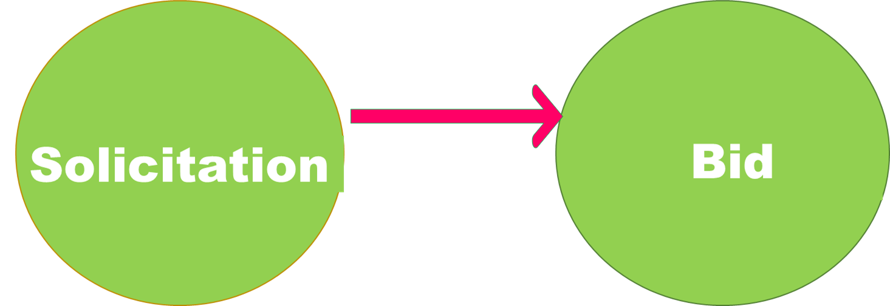
Decoding the Solicitation
Getting Ready to Respond to an Invitation to Bid

Slide 11
Responding to Invitation for Bibs (IFBs)
Buyer’s Request
Bid
Award
State the customer’s needs and requirements as you understand them.
Now is the time:
List the products or services your company provides that will help the customer achieve their objectives.
Compare costs of your product or service with one or more competitors.
Submit amount incl. price-related factors; i.e., shipping & handling you want to be paid from the customer. This will be a firm-fixed price for common items.
If award is won, deliver. If award is not won, request a “debriefing.”

Slide 12
What influences awards based on Bids?
Price-Related Factors
Price
Bidder Responsibility
Bid Responsiveness

Slide 13
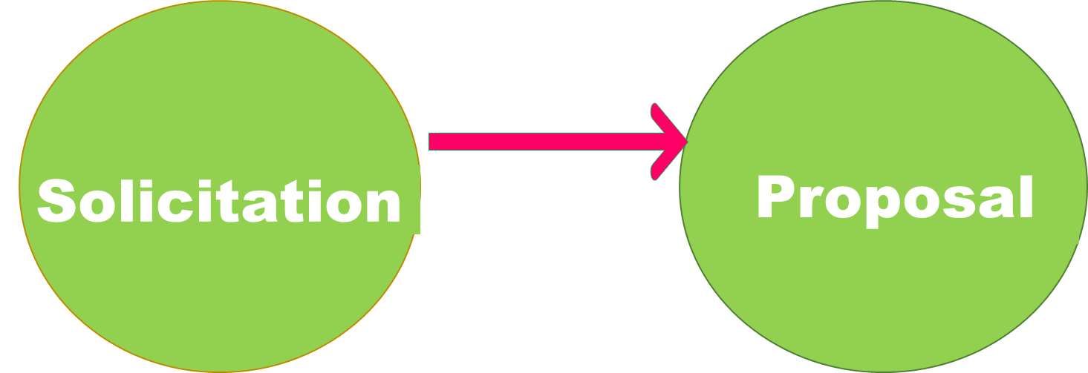
Decoding the Solicitation
Getting Ready to Respond to a Request for Proposal

Slide 14
Responding to a Request for Proposal
Read and re-read it!
Read reference to the FAR and related Supplements
Assume nothing.
Understand everything.
If given the opportunity, submit questions.
Order any specs and standards immediately.
Bonus: Be aware of the type of solicitation and type of pricing. (Next 4 slides)

Slide 15
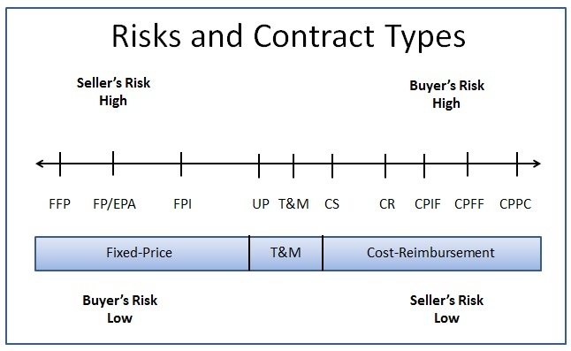
There are Different Types of Contracts
The solicitation document will tell you which form of pricing is expected.

Slide 16
Responding to a Request for Proposal
READ and RE-READ and summarize in your own words what the customer’s needs and requirements as you understand them.
Identify the “Must,” “Will,” and “Shall” actions contractors must fulfill
Participate in pre-proposal conferences
Submit and/or read, re-read answers to the Qs & As within the requisite time frame
Envision how you are the Customer’s Solution Expert
Anticipate what will be called for
Identify resources needed
Form a team, if necessary

Slide 17
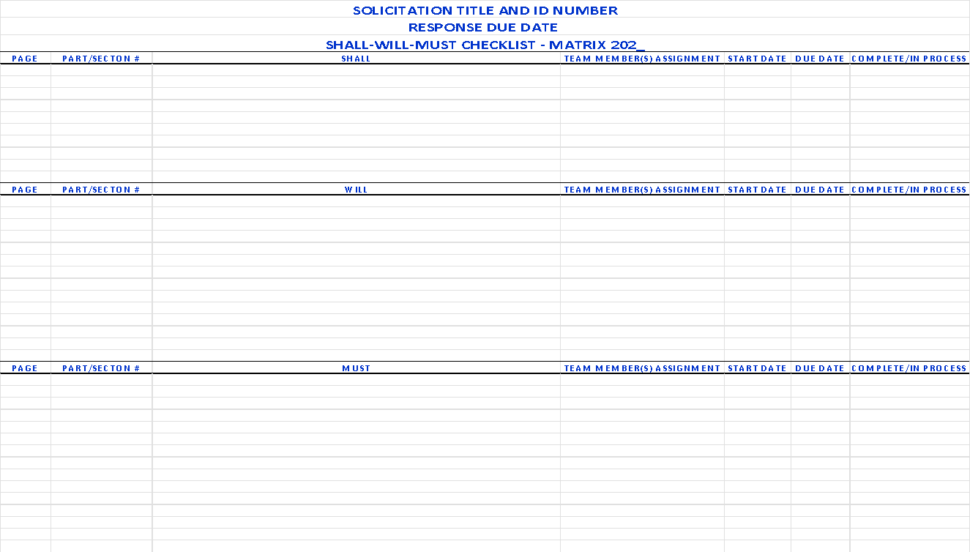
Key “Action” Words Matrix

Slide 18
FEDERAL UNIFORM CONTRACT FORMAT
Every RFP and IFB, the government tells you the exact work you’ll be doing, how to organize the proposal, and how it will be scored and awarded.
Follow the RFP to develop your Response.
The Government is telling what their needs are – not what you envision they are or should be – and more importantly, how will you satisfy those needs.
Start early!

Slide 19
Federal Uniform Contract Format
Part 1 – The Schedule
Section A. Standard Form 18, 33, 30, 1449, etc.
Section B. Supplies or Services and Prices/Costs
Section C. Statement of Work (SOW) or Performance Work Statement (PWS)
Section D. Packaging and Marking
Section E Inspection and Acceptance
Section F Deliveries or Performance
Section G Contract Administration Data
Section H Special Contract Requirements
Part II – Contract Clauses
Section I. Contract Clauses
Part III – List of Documents, Exhibits and Other Attachments
Section J. List of Attachments
Part IV – Representations and Instructions
Section K. Representation and Certifications and Other Statements of Offerors
Section L. Instructions to Offerors
Section M. Evaluation Criteria for Contract Award

Slide 20
Understanding the Relationship - The Solicitation and Your Proposal
You Must Know This
To Understand This
Government Solicitation
Contractor Proposal
Statement of Work
Section C
Performance Work Statement
Requirement
Technical
Past Performance
Price
Section L
Instructions to Offerors
Format
Section M
Evaluation Factors
Degree of Value

Slide 21
Gating Process
Is the opportunity consistent with your business plan?
Do you have adequate capacity, equipment and personnel?
Do you have (or can you acquire) sufficient experience?
Can you beat the competition?
Is the risk manageable?
Can you make money?
Make a “Go / No-Go” decision … tool on next slide

Slide 22
Go/No-Go Decision Tool
Go/No-Go Decision Tool
Proposal/Project Manager ___________________ |  |  |  |  |  |  |  | Name of Agency ____________________
Office Location ___________________ |  |  |  |  |  |  |  | Solicitation # ____________________
Business Unit ___________________ |  |  |  |  |  |  |  | Estimated Total Value ____________________
Estimated Proposal Cost ___________________ |  |  |  |  |  |  |  | Per Year Value ____________________
Bid Factors | Bid Factor Scoring Scale |  |  |  |  |  |  |  |  |  |  |  | Estimated Score
 | Negative |  |  |  | Neutral |  |  |  | Positive |  |  |  | Our Company | Top Competitor
 | 1 | 2 | 3 |  | 4 | 5 | 6 |  | 7 | 8 | 9 | 10
1.Are you known by the client? | Unknown to this client |  |  |  | Known to client, but not fully cultivated |  |  |  | Well-developed working relationship; previous contracts
2.Is this the first you heard of procurement? | Did not expect RFP; unprepared |  |  |  | Generally up-to-date; no major negatives |  |  |  | Known 3-12 months; good favorable, confirmed intelligence
3.What is our overall technical capability/position? | Not qualified; weak relevant experience |  |  |  | Capable; understand problem; experienced |  |  |  | Can meet/exceed every requirement; technically superior
4.Can we provide proof of qualified staff? | Limited in-house staff available |  |  |  | Good in-house staff available |  |  |  | Best in-house staff available
5.Are subcontractors needed? | Yes, but will dilute position |  |  |  | Yes, but will have little or no effect |  |  |  | Yes, and will enhance overall proposal
6.What is the financial potential? | Marginal long term; no short-term return |  |  |  | Good long term; questionable short term |  |  |  | Excellent long term; excellent short term
7.Can we respond with a complete, compelling proposal? | Unclear understanding of problem/project needs; limited response |  |  |  | Understand problems, project & client needs; can respond |  |  |  | Can meet/exceed all requirements; have compelling story; know hot buttons
8.Who are our competitors? | Competitor is strongly favored or UNKNOWN |  |  |  | Open competition with no strong favorite |  |  |  | We are strongly favored over competition; incumbent
9.Is project within our geographic region? | Poor geographic presence/experience |  |  |  | Good geographic presence/experience |  |  |  | Strong geographic presence and experience
10.What is our pricing competitiveness? | Must cut corners; cost share; risky |  |  |  | Reasonable & competitive; reasonable risks |  |  |  | Honest, credible price within known limits; acceptable risks
Total score of factors evaluated
Maximum potential score (number of factors evaluated above times 10)
Decision (Total score should be about 75+% of maximum score for a "Go" decision, or better than the top competitor.) _______Go ________No Go

Slide 23
Digest the Statement of Work (SOW)
Make sure you can perform all the work.
Call in others who can assist, form a team.
Begin to articulate why you should be awarded the contract.
Plan to incorporate this thinking into your proposal
Rate yourself objectively against any evaluation criteria

Slide 24
Responding to a Request for Proposal
Market entry strategies – Who’s Buying/Bought What Your Selling?
Your Solutions, Resources, Differentiators, Competitive Pricing
Who is the Actual End User?
Current Incumbent/Awardee, Contract Type, Term of Contract, Dollar Value of the Contract

Slide 25
The Concepts of Responsiveness and Responsibility
Responsiveness refers to your OFFER – your submittal in response to the invitation
Following instructions.
Timeliness
Compliant
Responsibility refers to YOU – your qualifications and ability to perform.
A judgement is made about your wherewithal

Slide 26
The Technical Proposal
May be required to address
Management & personnel
Past performance
Technical issues – how you will technically perform the work required
Facilities
Quality assurance
Environmental concerns
Security
Look for guidance in SOW – Sections C, L and M
Explain how you will perform the SOW in clear and concise terms

Slide 27
The Technical Proposal
Your proposal must be more than just compliant and complete; it needs to be compelling. Your proposal must convince the Customer that not only can you do the job, but it also distinguishes you as their choice to do the job.
Attention to detail is paramount. If you are asked 100 questions, answer 100, not 99 or 101.
Your proposal now will be viewed as your work later (no errors)
You cannot be late!

Slide 28
Master the Evaluation (Selection)Criteria
Understand that these are the grounds on which you will be selected – or not.
If you were the buyer, think about what qualities in a vendor you would look for.
Create a method you can refer to the selection criteria, – often – and figure out how you can incorporate them into your proposal.

Slide 29
Assign Responsibilities and Update Task Schedule
Make sure everyone knows their role, who’s in charge, and what the deadlines are
Update proposal development schedule daily
Establish back-up plans
Don’t forget to allow time for delivery
Identify documents, specifications and standards needed.
Make a GANTT Chart
Blue team writes the proposal or bid
Red team reviews your drafts along the way and cross-references them with the solicitation

Slide 30
SOLICITATION TITLE AND ID NUMBER
DATE TRACKING GANTT CHART
 | Date Tracking Gantt Chart
 | Track today's date? |  | Yes
 | Milestones |  |  |  |  | Tasks
 | This column should be ordered sequentially. | The position column, charts milestones within the task chart. | Enter the date for a milestone in this column. | Enter a milestone description in this column. These descriptions will appear in the chart. |  | This column should be ordered sequentially. | Enter the start date for each task below. For best results sort this column in ascending order. | Enter the end date for each task or activity below, in this column. | Enter tasks and/or activities in this column.
 | No. | Position | date | Milestone |  | No. | Start Date | End Date | Task
 | 1 | 1 | 7/5/2022 | Milestone 1 |  | 1 | 6/25/2022 | 6/26/2022 | Activity 1
 | 2 | 1 | 7/21/2022 | Milestone 2 |  | 2 | 6/26/2022 | 6/27/2022 | Activity 2
 | 3 | 1 | 7/31/2022 | Milestone 3 |  | 3 | 6/26/2022 | 7/1/2022 | Activity 3
 | 4 | 1 | 8/10/2022 | Milestone 4 |  | 4 | 6/27/2022 | 7/4/2022 | Activity 4
 | 5 | 1 | 8/25/2022 | Milestone 5 |  | 5 | 7/4/2022 | 7/14/2022 | Activity 5
 | 6 | 1 | 9/4/2022 | Milestone 6 |  | 6 | 7/8/2022 | 8/7/2022 | Activity 6
 |  |  |  |  |  | 7 | 7/11/2022 | 7/26/2022 | Activity 7
 |  |  |  |  |  | 8 | 7/21/2022 | 7/26/2022 | Activity 8
 |  |  |  |  |  | 9 | 7/30/2022 | 8/1/2022 | Activity 9
 |  |  |  |  |  | 10 | 8/5/2022 | 9/4/2022 | Activity 10
 |  |  |  |  |  | 11 | 8/7/2022 | 8/30/2022 | Activity 11
 |  |  |  |  |  | 12 | 8/15/2022 | 8/20/2022 | Activity 12
 | To add more Milestones, add a new row above this one.
 |  |  |  |  |  | To add more Tasks, add a new row above this one.

Slide 31
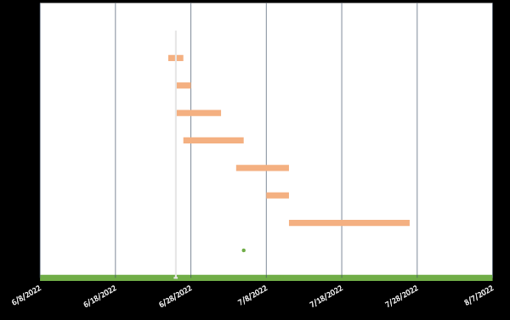
SOLICITATION TITLE AND ID NUMBER
DATE TRACKING GANTT CHART

Slide 32
General Proposal Outline
Executive Summary and/or Introduction – Who you are (incl. your team), and what the reader can expect in the following pages. This section has all the answers at a highly, concise level for the CO/KO, Contracting and Evaluation Team
Technical Approach
Management Approach
Key Project Personnel and Resumes
Past Performance
Risk and Risk Mitigation
Quality Control
Cost/Price Proposal – Requirement as a separate volume

Slide 33
Keys to Proposal Success
Executive Summary should be written by the “Proposal Manager” or lead person in charge
Most Important Section (sets the stage and flow of the proposal)
Style and language must be convincing
Write Exec Summary first
Influences train of thought
Guides rest of proposal
Difficult if done last
Adjust as necessary as you write other parts
May use some graphics
Limit to one/two pages

Slide 34
The Cost/Price Proposal
Make best offer first time
Best And Final Offer (BAFO) request may come into play, but don’t count on it
Double-check numbers
Make it easy to read
Not in business to lose money
Recover costs & Return on investment
Reasonable profit (govt. expects you will make some profit)

Slide 35
The Cost/Price Proposal
When estimating costs/price
Factor your direct costs (actual cost of the goods, labor, supplies, equipment) necessary carry out the requirements of the contract, award, task order
But don’t forget your indirect costs to perform (overhead + general and administrative expenses or G&A), this includes management salaries, utilities, insurance, bonding, rent, janitorial, office supplies, transportation, depreciation, legal fees, training, tax issues and liability

Slide 36
The Cost/Price Proposal
Factor in a reasonable profit or fee
Direct costs + Indirect costs (overhead + G&A) + Profit/fee = Bid price
Army Contracting Guide:
While overhead varies per type of contact, typically 15% of total direct costs
G&A is normally between 12-15% of the sum of direct costs + overhead
Formula: G&A + Overhead = Total Indirect Costs
Typical profit on fixed price contract is 5% (large) and 12% (small business, always somewhere between 5%-12%
If cost contract (reimbursed for actual costs), profit/fees on cost contracts generally run 5% for all firm sizes.

Slide 37
Bringing It All Together
End your proposal briefly summarizing the problem, solution, and benefits. Emphasize the significant parts and submit a proposal that makes it stand out by restating ideas or facts you want your audience to remember.
A team of people must read your proposal along with every other proposal submitted.
Make your proposal compelling, stands out!
Make responses to the contract requirements clear and easy to identify and understand.
Be detailed regarding your execution plan.
Make your proposal EASY TO READ.

Slide 38
Keys to Proposal Success
The purpose of a proposal is to sell & win the award
Winning proposals distinguish themselves from the competition
Convince the evaluators that you are better than the competition
Convince the evaluators that your solution is clearly advantageous to them due to factors such as understanding buyer’s need/goal, technical merit, value added, price, risk adverse, team wherewithal, etc.
Convince the evaluators that your firm will cause the least amount of problems, disruptions
CO do not like risk – they want certainty, character, capability, delivery
Headings and Sub-headings included in your proposal parallels the organization and requirements in the solicitation

Slide 39
Proposals Lose Points
Lack of preparation
Failure to follow instructions – non-responsive
Questionable understanding of requirements
Incomplete responses—no specifics
Noncompliance with specification
Insufficient resources or insufficient information about resources
Technical/price imbalance – you can be too low or too high (shows you don’t understand req.)
Poor proposal organization – not logical
Wordiness, but not addressing key factors

Slide 40
2
Little value offered
Value proposition is not conveyed
Hype certifications rather than conveying specific plan to help accomplish government requirements
Failure to show relevance of past performance
Unsubstantiated rationale for approaches
Restating requirements without explaining how they will be performed
Selling what the government is not buying
Lack of senior leadership buy-in and resources
Unprofessional appearance, typos, unnumbered pages, poor grammar, etc.

Slide 41
Questions?

Slide 42
Thank You!

