Slide 1
Small Business Works 2022:
Technology Transformation Services Overview
U.S. General Services Administration

Slide 2
Technology Transformation Services (TTS) Overview
Laurie MacNamara
Director of Market Development and Partnerships Division
Technology Transformation Services
U.S. General Services Administration

Slide 3
TTS Overview
TTS as the go-to tech provider
22+ products and services
Fast, agile and high profile
Partnered with almost every agency in government
Focused on public-facing digital services
Directly supporting and leading cross-gov initiatives, such as the President’s Management Agenda and the Executive Order on Transforming Federal Customer Experience and Service Delivery to Rebuild Trust in Government
Vision: Trusted, modern government experiences for all.
Mission: Design and deliver a digital government with and for the American public.
Notes:
Every interaction with the public is an opportunity to improve trust in the government. TTS exists to design and deliver a digital government with and for the American people. We apply modern methodologies and technologies to improve the lives of the public and public servants. We help agencies make their services more accessible, efficient, and effective with modern applications, platforms, processes, personnel, and software solutions.
What is TTS?
We’re an organization that’s been around for 50+ years and now is composed of nearly 400 humans who live and work across the country, united in our desire to serve the public.
Over the years, as the public’s ways of interacting with the federal government expanded, so did our organization, as we delivered programs and services that supported federal agencies meeting their missions and brought together professionals to share expertise and lessons learned from across the government through our many communities of practice.
As our influence expanded we began offering consulting services to agencies to help them build and buy better products or start them on their journeys of enterprise-wide modernization, bringing in our experience working alongside our partners for many years.
Recently, under the mandate of the President’s Management Agenda and Customer Experience Executive Order, we’ve begun the pivot back to more directly supporting the public in all we do, in order to have the most impact. We are moving towards our North Star of directly delivering services to the public.
We’re excited you’re joining us at this momentous time in our organization’s history as we create the infrastructure and activate our communities to move forward with our users at the center of our work, especially those who have been traditionally marginalized and excluded from accessing government services.

Slide 4
TTS Strategy: Our North Star
Direct service delivery with a roadmap driven by the public, for the public, with the public… through shared platforms, tools, and investment in communities of practice and innovation.

Slide 5
TTS Strategy: We are Pivoting
CURRENT STATE
FUTURE STATE
Public-driven
Interactions with government are optimized for the public. TTS provides platform for “turn key services” building on existing offerings.
Agency-driven
Interactions with government are optimized for agencies. Agencies build and manage all aspects of their own platform.

Slide 6
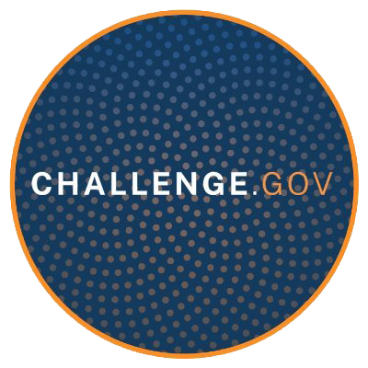
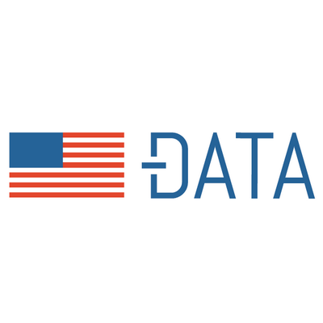
How TTS Delivers
USAGov
MAX.gov
DAP
Digital.gov
Vote.gov
10x
Centers of Excellence
Touchpoints
FedRAMP
USWDS
Api.data.gov
Challenge.gov
Cloud.gov
18F
Citizenscience.gov
Data.gov
Code.gov
Search.gov
Login.gov
Digital Corps
Presidential Innovation Fellows
Notes:
How does TTS deliver on this mission? TTS is made up of: the TTS Advisory and Delivery which is:
IT Modernization Centers of Excellence (CoE): A centralized team of technical experts that accelerate agency-wide IT modernization.
18F: A digital consulting office that partners with federal agencies to help them build or buy digital services.
Presidential Innovation Fellowship (PIF): A program that pairs top technologists with civil-servants to spend 12 months tackling some of our nation’s biggest challenges.
U.S. Digital Corps: a new two‑year fellowship for early‑career technologists who will work every day to make a difference in critical impact areas including coronavirus response, economic recovery, cybersecurity, and racial equity.
TTS products & platforms: A diverse portfolio of products and platforms that help agencies improve delivery of information and services to the public.
Each logo is hyperlinked for more details
Login.gov is a shared service, used by the public, and trusted by government agencies. A cloud-based remote identity proofing platform. If you apply through USAjobs, you are using login.gov.
Login.gov is a shared service, used by the public, and trusted by government agencies. A cloud-based remote identity proofing platform. With one login.gov account, you eliminate the need to remember different passwords for each agency and streamline your sign in process. If you apply through USAjobs, you are using login.gov. A few other interesting facts about login.gov….there are 28.8 million user accounts and 135+million sign in’s weekly.
10X: At 10x, we crowdsource ideas from federal employees and turn them into real products that improve the public’s experience with the federal government.

Slide 7
TTS Values & Code of Conduct
Our Values and Code of Conduct were created by employees from across the organization:
INCLUSION
INTEGRITY
IMPACT
We put people first and celebrate what brings us together and makes each of us unique to meet the public’s needs.
We are present, transparent, and honest to enable accessible and trustworthy innovation.
We grow together and create lasting change for the good of the public and public servants.
Learn more about our mission, history and values in our Handbook.
Notes:
TTS Values & our Code of Conduct: Our code of conduct was actually developed by our employees from across the org. We strive to create a welcoming and inclusive culture that empowers people to provide outstanding public service.
We want our team and our workplace culture to reflect and celebrate the diversity of the communities we serve.
Our code of conduct addresses inclusion, integrity and impact. You can learn more about this in our handbook which is linked here.
We believe a more diverse organization creates a broader spectrum of solutions and ideas, and helps us challenge status quo thinking. Along these lines, we’ve worked hard to improve our hiring process to move toward a more equitable and consistent process. Next slide.

Slide 8
How We Work: Focusing on the User
Although TTS has always lived by the principles of human-centered design, we are incorporating the user into how we measure value and impact.
We are building on our strengths that we have been delivering for over 50 years.
We define customer experience as looking at the human and not at the data.

Slide 9
How We Work: Equity at TTS
Putting equity in all that we do, TTS sees this not only internally in our hiring and growth but also in what we buy and build for our partners.
By prioritizing an equity-focused, people-centered approach to our design practices, we can proactively reduce negative impacts and improve usability and accessibility of our products for the user.

Slide 10
TTS Products and Services

Slide 11
How TTS Delivers
Shared Technical Infrastructure
Help federal, state, local and tribal agencies deliver for the public better and faster.
1
Shared Platforms
Centralize shared needs across agencies on high-performance platforms.
2
Talent & Communities
Catalyze agency progress through training, consulting and collaboration.
3

Slide 12
Login.gov
SHARED TECHNICAL INFRASTRUCTURE
1
Authentication
Equity
“Let me seamlessly sign up and log in to government services.”
…while investing in overcoming the imbalances in access to government services.
Identification
Privacy
“Let me easily prove I am who I say I am.”
…while keeping a person’s information private.
Authorization
Security
“Let me privately share my profile information with govt agencies that need it to serve me.”
…while keeping systems and info secure.
Notes:
One example of shared technical infrastructure is Login.gov, our authentication product.
- The mission of Login is to simplify secure access to online government services for the public, and reduce costs and complexity for agencies.
- Login.gov continually iterates to provide equitable, simple and secure access to critical government services for the entire public.
- Login.gov provides strong authentication and identity verification as a shared service to government agencies.
- Built by digital service experts with government and industry experience, Login.gov was built with the user in mind and believes in continuous improvement. The team is constantly listening to the public and agencies alike to address issues and following agile practices, deploy code to production every two weeks.

Slide 13
USAGov
SHARED PLATFORMS
2
TASKS
LIFE EXPERIENCES
Notes:
USAGov aggregates government information in both English and Spanish and organizes it in an agency-agnostic manner, focusing on life events and top tasks. Since 2019, USA.gov and USAGov en Español have been visited more than 273 million times; and USAGov’s contact center has managed about 2.6 million calls, chats and emails. Based on all these interactions with the public, USAGov has deep knowledge and understanding of customers’ pain points when interacting with the government. In order to address these needs, USAGov is undertaking an effort to reimagine the experience on USA.gov, USAGov en Español and the USAGov contact center.

Slide 14
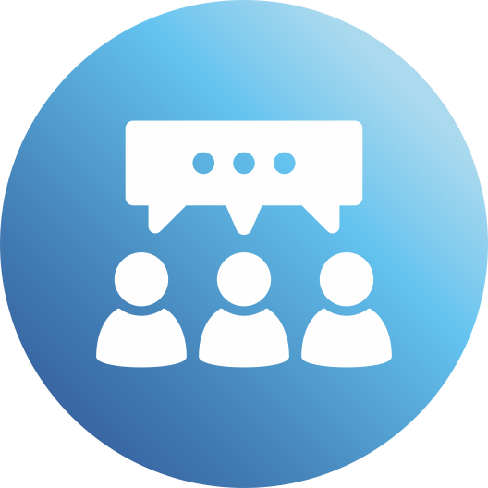
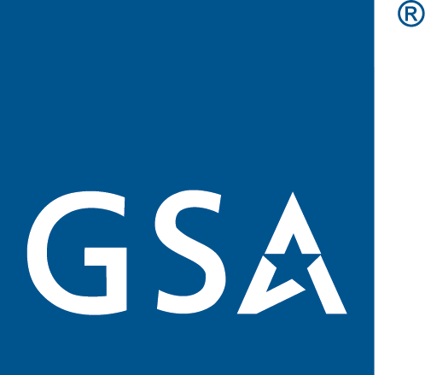
TTS Consulting Services
TALENT & COMMUNITIES
3
Department of Agriculture
Department of Homeland Security
Department of Labor
General Services Administration
Social Security Administration
Department of Health and Human Sciences
Department of the Interior
Department of Veteran Affairs
Internal Revenue Services
Notes:
Department of Agriculture
Department of Health and Human Sciences
Department of Homeland Security
Department of Labor
Department of The Interior
Department of Veteran Affairs
General Services Administration
Internal Revenue Services
Social Security Administration

Slide 15
TTS Support to the PMA

Slide 16
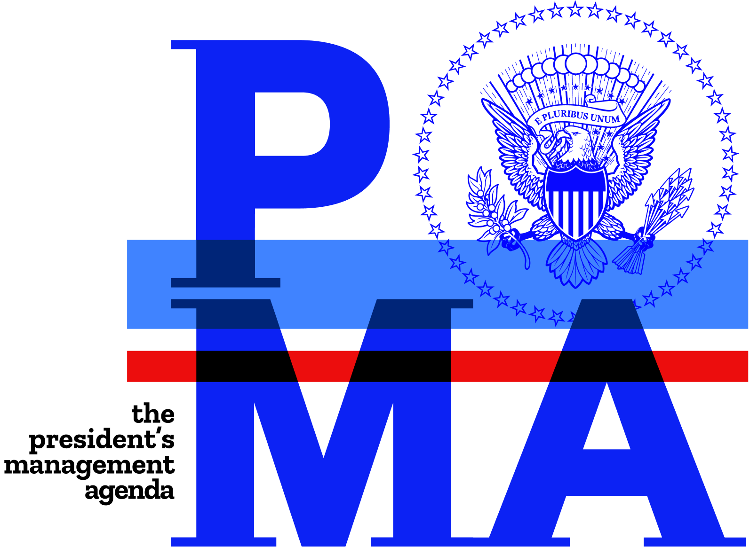
TTS and PMA’s Priority Area 2
Delivering Excellent, Equitable, and Secure Federal Services and Customer Experience
Strategy 1: High-Impact Service Provider (HISP) support
TTS has deployed design and development teams to work side-by-side with agency CX teams at four HISP agencies to date, with more planned
TTS’s own USA.Gov has been designated as a HISP with enhanced CX emphasis
Strategy 2: Life Event-focused service delivery across agencies
TTS is working with OMB-led LE discovery teams focused on disaster recovery and facing a financial shock to determine common needs for shareable tools
Strategy 3: Development of Federal shared products, services, and standards
TTS is introducing both current and new products and tools to meet CX objectives

Slide 17
Questions and Answers
?

Slide 18
Thank You!
POWERED BY
TECHNOLOGY TRANSFORMATION SERVICES

