Slide 1
The Pricing Suite
Is Right
February 2, 2024
Office of Integrated Marketing
Notes:
Andrea
Welcome! My name is Andrea Azarcon Heller. I’m a former Level II Contracting Officer and co-facilitator for GSA’s Civilian Services Acquisition Workshops.

Slide 2
Agenda
Scenarios for using Pricing Central
Cost Accounting Basics
Brain Break! Chatterfall
What an Independent Government Cost Estimate (IGCE) is and why it’s important
Live Demos of the IGCE tool using
CALC+ Quick Rate
Hourly Labor Ceiling Prices
Prices Paid
Q&A
Notes:
Kelly
Agenda
Today we will discuss:
When and why you would use the tools in Pricing Central,
Help you understand the foundation of cost accounting (necessary and not as boring as some of you might think)
We’ll do a quick interactive exercise (more on that later)
Define what an Independent Government Cost Estimate is and it’s value
Do case studies to demonstrate the IGCE tool and the data on CALC+ Quick Rate (Hourly Labor Ceiling Prices and Prices Paid) - all within Pricing Central on buy.gsa.gov
Address and questions we haven’t gotten to during the presentation

Slide 3
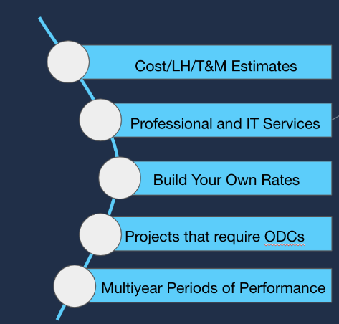
Why use the tools in Pricing Central?
Notes:
Andrea
Why use the tools in Pricing Central?
If you’re using the following contract types
Cost
Labor Hour/Time and Materials
You can use it for Firm FIxed Price, but we see it used more for the other two
Professional Services, IT services (since that’s what most of the data is)
If you need to load your own rates (the tool helps you do the math). It will then aggregate the manually loaded rates with the values for the cost accounting elements that you also manually load to sum up the actual rate for estimation purposes.
When your project has Other Direct Costs
The periods of performance are multiyear
Pricing includes Industrial Funding Fee (IFF) or contract access fees

Slide 4
Poll
How would you describe your level of experience with cost accounting concepts and terms?
Notes:
Kelly
Poll
Before we keep going, let’s do a poll so I can gauge your level of knowledge around this topic. In the poll, please share your level of experience with cost accounting concepts and terms. No wrong answers, no judgement.
Options:
“I could teach this class and am only here for the CLPs”
”I know some and need a refresh”
“I can balance my checkbook, does that count?”
Pause while people type in their answers. Get uncomfortable with the silence. Once you notice the majority of attendees put their answers in the chat, highlight some of the answers before going to the next slide.

Slide 5
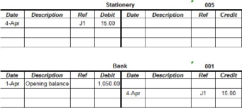
Cost Accounting Basics
#NotLikeYourCheckbook
A standard way of calculating what labor and materials will cost
Often based on projections, but can include historical pricing if you have it
Costs are grouped into like “pools”
Some basis in known cost inputs
Cost of materials
Tax rates
Leases
Notes:
Kelly
Cost Accounting Basics
Ok, so it’s NOT like your checkbook.
Cost accounting is a standard way of calculating what labor and materials will cost. Like costs grouped together so you can see the full cost of a product or service..
Usually based on projections and known cost inputs, and can also include historical pricing if you have access to it.

Slide 6
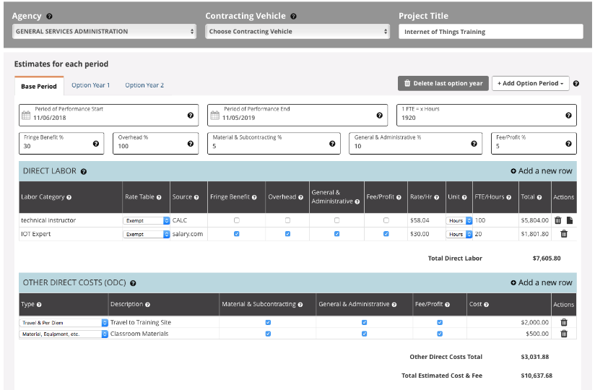
Key Concepts
Notes:
Kelly
Key Concepts
We will next highlight some of these key concepts. Pay attention to the elements highlighted in the yellow box (Fringe, Overhead, Materials and Subcontracting which come into play for Other Direct Costs, and Fee/Profit). We will explain what those things are as well as how they are loaded into a labor rate (if you need to do that yourself).

Slide 7
Key Concepts
Labor | Materials | Overhead/ G&A | Profit (Fee)
Direct or Indirect | Direct or Indirect | Organizations that help the organization be an organization | How the company makes money!
Notes:
Andrea
Key Concepts
These are the key concepts we get questions on the most.

Slide 8
Direct Labor
The costs of having a person do something
Usually is in the form of salary or hourly wages
Sources:
Payroll Records
Historical Averages
Third-party salary databases (eg salary.com, glassdoor.com)
Bureau of Labor Statistics
This is an unloaded rate!
Notes:
Andrea
Direct Labor
Money paid for the person doing the thing you want them to do per the requirements. You can (and should!) get this information from various sources to make an estimate.
Direct Labor is an unloaded rate, and cost accounting elements will need to be added to get an estimate (more on this later).

Slide 9
Indirect Labor or Costs
Money that supports the contractor who is providing the service to you
Fringe
Vacation Time
Health Insurance Contributions
Payroll Taxes
Overhead (business unit)
Stuff necessary to operate a business
Leased Office Space
Support Staff
Utilities
Notes:
Andrea
Indirect Labor
Money paid for the person doing the thing you want them to do but NOT for the thing you want them to do. It’s for things like their benefits, taxes, and overhead (because someone has to process their benefits and someone has to make sure taxes get paid). Sometimes this can overlap with General and Administrative costs (more on this later).

Slide 10
Direct Materials
Items needed for the job
Other Direct Costs (ODCs)
Travel and Per Diem
Express mail/shipping charges
Classroom materials (books, office supplies)
Subcontracting
Notes:
Kelly
Direct Materials
Money paid for the items needed in order for the person doing the thing you want them to do per the requirements.
Travel costs can be estimated using published government per diem rates as well as third-party travel sites.
Materials can be estimated using sites like GSA Advantage!, various GSA commercial platforms (Amazon, Overstock, and Fisher Scientific), as well as your good old favorite search engine :)

Slide 11
Indirect Rates-Materials
Generally the costs of buying and managing ODCs
Materials and Subcontracting
Examples
Warehouse space
Purchasing Office
Subcontract Management
Notes:
Kelly
Indirect Rates-Materials
Money paid for other direct costs to be purchased, used, and managed.

Slide 12
General and Administrative (or Overhead)
SIMILAR, yet different
Overhead: supports a geographical area or business line
General and Administrative or G&A: enterprise costs (all business units)
Examples
Executive Leadership
Headquarters Building
HR Services
Accounting and Legal Services
-GRCPA
Notes:
Kelly
Overhead/G&A
Money paid for organizations that help the organization BE an organization. Think operations. Finance, Legal, Marketing, etc.
https://www.grfcpa.com/2023/01/understanding-the-difference-between-overhead-and-ga/
Sometimes G&A and Overhead can overlap. It is up to the vendor and their accounting practices as to which category these costs get allocated to.

Slide 13
Profit (Fee)
Rewards the contractor for providing the product or service
In federal contracting, should be relative to the level of risk assumed by the contractor to perform the contract
Fixed Price = Higher Risk, Higher Profit
Cost Reimbursable = Lower Risk, Lower Profit
Fee is used in reference to cost reimbursable contracts
Notes:
Kelly
Profit (Fee)
Fee is usually used in reference to cost reimbursable contracts but they are conceptually the same.

Slide 14
Loaded versus Unloaded Rates
Loaded Rates: include all Fringe, Overhead, G&A and Profit (fee)
Example = CALC+ Quick Rate (Hourly Ceiling Labor Rates, Prices Paid)
Unloaded Rates: only Direct Labor. Comes from sources such as (and not limited to) Bureau of Labor Statistics
The IGCE Tool allows for loaded or unloaded rates (build your own) OR a combination of both
Unloaded
Loaded
Notes:
Kelly
Loaded versus Unloaded rates
Labor rates are like a baked potato. Loaded rates, like a loaded baked potato, include everything. Unloaded labor rates include ONLY direct labor. It’s just the potato.
Note: BLS data is not loaded, and you will need to load the rates yourself using the IGCE tool.

Slide 15
First Pause for Questions
Notes:
Both
First Pause for Questions
Address Questions that have been asked thus far.

Slide 16
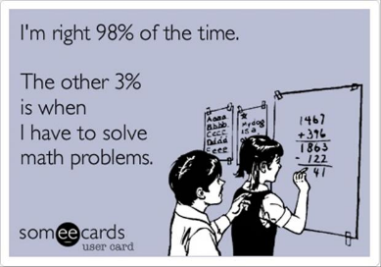
What is an Independent Government Cost Estimate?
Notes:
Andrea
What is an Independent Government Cost Estimate?
Now we’ll go into an IGCE and some case studies for the pricing tools.

Slide 17
Department of Interior
“The government is entitled to receive quality supplies and services at fair prices. Under normal market conditions, competing offers ensure that adequate value is received.
The contracting officer relies on the IGCE to assist in the determination of the acquisition strategy, as well as an estimated cost for the proposed effort....
Notes:
Kelly
Definition of an IGCE
Definition from the Department of Interior on why an IGCE is important.
Buyers SHOULD receive goods that are safe and services that meet the requirements. The IGCE is one tool that’s used to ensure this happens.
Per the Federal Acquisition Regulations (FAR): “Independent government estimate (IGE),”...means the Government’s estimate of the projected price or cost that a contractor would incur in the successful performance of a contract.
Note: IGE and IGCE are terms used interchangeably, but they are essentially the same.

Slide 18
Chatterfall
We ask a question
You type your answer in the chat but DO NOT PUSH ENTER OR RETURN UNTIL WE SAY SO
When you push Enter/Return, everyone else will too! Answers will appear in the chat like a waterfall or “chatterfall”
Credit: Jonathan Evans and Erika Oberle, PSHC
Notes:
Kelly
Chatterfall
This is an exercise you do with the attendees assuming this is conducted in a virtual environment. You can also do this in an in-person setting with sticky notes, index cards, or other small pieces of paper and pens/pencils/markers.
Before we keep going, let’s have a group discussion. We’re going to do a Chatterfall.

Slide 19
Chatterfall
Who is responsible for the IGCE?
Notes:
Kelly
Chatterfall
Today’s question: WHO is responsible for the IGCE?
Pause while people type in their answers. Get uncomfortable with the silence. Once you notice the majority of attendees put their answers in the chat, highlight some of the answers before going to the next slide.

Slide 20
Who is responsible for the IGCE?
We asked GSA employees and the TechAcq listserv…
The Program Manager develops it. The Contracting Officer checks it for reasonableness.
The COR may assist, if they have been identified early. Keep in mind that most CORs have not been identified/appointed by the CO until time of award with appointment letter.
Notes:
Andrea
Who is responsible for the IGCE?
Classic answer-it depends. Here is what folks shared with us.

Slide 21
Who is responsible for the IGCE?
We asked GSA employees and the TechAcq listserv…
With all things the CO is ultimately responsible. Accept the IGE from the Program/Requesting office and review the material with the rest of the Contracting Team to see if you can follow the logic of the data presented. If there are any questions, concerns address them with the requesting office. You may consider, did they account for today's market (supply chain increases/delays), inflation for out years, technology changes, etc.
Notes:
Andrea
Who is responsible for the IGCE?
Here’s another response to the question.

Slide 22
Who is responsible for the IGCE?
We asked GSA employees and the TechAcq listserv…
The CO plays a role, or should play a role, to lead the IGCE process since they are ultimately the business person. Many of you may find that when the proposals arrive the technical evaluation team get the proposal but not the prices. Many COs make the price determination.
Notes:
Andrea
Who is responsible for the IGCE?
And finally, this person indicated the CO should lead the process. All of the answers you’ve seen/heard are correct. This is a team effort!

Slide 23
An underestimated project can result in...
Not enough funding
Delayed and iterative proposal processes
Negotiation difficulties/delays, and other internal administrative problems
Notes:
Kelly
An underestimated project can result in…
Anti-deficiency = BAD
Delays = extended Procurement Acquisition Lead Times (PALT) times, negative impact on mission. Program-YOU might not care about the PALT, but your contracting folks are measured on this!

Slide 24
Case Study #1 Economic Analysis Support Services
The Office of the Chief Economist of Economic Economics is conducting an economic analysis* for the development of regulations, reports and Information Collection Requests to comply with executive orders.
Notes:
Andrea
Case Study #1
*economic analysis includes: benefit-cost analysis, economic impact analysis, modeling and simulation, risk analysis and a quantitative policy analysis.

Slide 25
Case Study #1 Economic Analysis Support Services
Project management, change management, and communications support for:
Project Manager
Program Manager
Redundantly Analytical Analyst
Economist
Notes:
Case Study #1
These are the labor categories we will find rates for.

Slide 26
Case Study #1 Economic Analysis Support Services
Labor Categories
Project Manager-Hourly Labor Ceiling Rate
Program Manager-Hourly Labor Ceiling Rate
Redundantly Analytical Analyst (manual entry)
Economist-Hourly Labor Ceiling Rate
Notes:
Andrea
Case Study #1
These are the labor categories we will find rates for and where the data will come from.

Slide 27
Live Demo
Notes:
Andrea

Slide 28
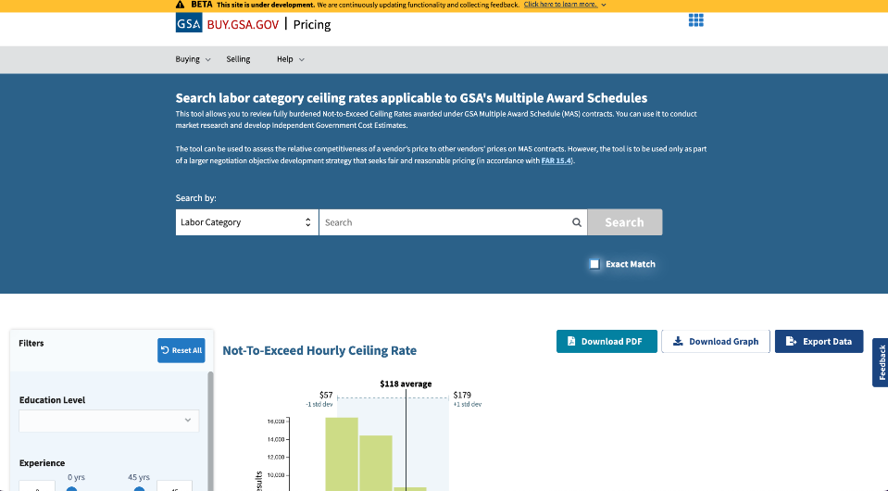
Search Labor Category Ceiling Rates
Notes:
CALC+ Quick Rate Screenshot
Use a search term to find hourly ceiling labor rates on GSA Multiple Award Schedule contracts. You can download the data as a PDF, graph, or export the data to Excel.

Slide 29
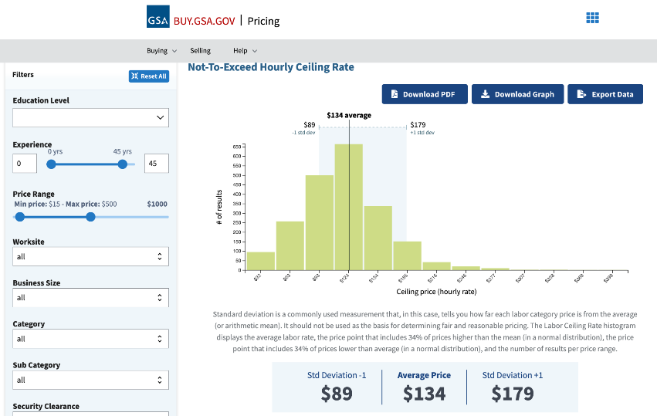
Not to Exceed Hourly Ceiling Rate
Notes:
CALC+ Quick Rate Screenshot
You can filter by education level, experience (by years), price range, worksite, business size, category/sub category, Special Item Number, and category. Click on each of the filter drop downs to show the various options. A bar chart appears on the right of the filters, and changes as you change the filters.

Slide 30
How a non-CALC Labor Category
gets calculated in the IGCE tool
$45 base rate per hour
25% Fringe
100% Overhead
10% G&A
5% Fee/Profit
1912 hours per FTE
2 FTE
Notes:
Kelly
How a non-CALC Labor Category gets calculated in the IGCE tool
Let’s load a labor rate together! We will use the values on the slide.

Slide 31
How a non-CALC Labor Category
gets calculated in the IGCE tool
BEWARE
COMPOUNDING
NUMBERS
Add Fringe
$45 base rate per hour
25% Fringe
$45 * 1.25 = $56.25
Notes:
Kelly
How a non-CALC Labor Category gets calculated in the IGCE tool
I like to be efficient. Instead of calculating 25% of $45, and then ADDING THAT to $45, I just multiply $45 times 1.25 so that extra 25% is already there. You will see me use this method throughout calculating the labor rate.

Slide 32
How a non-CALC Labor Category
gets calculated in the IGCE tool
Add Overhead
$56.25 (Base rate with Fringe)
100% Overhead
$56.25 * 2 = $112.50
Notes:
Kelly
How a non-CALC Labor Category gets calculated in the IGCE tool
Next, we’ll take the amount in the previous slide ($56.25) and since Overhead is 100%, I will multiply by two to increase that amount by 100%.

Slide 33
How a non-CALC Labor Category
gets calculated in the IGCE tool
Add G&A
$112.50 (Base rate with Fringe & Overhead)
10% G&A
$112.50 * 1.1 = $123.75
Notes:
Kelly
How a non-CALC Labor Category gets calculated in the IGCE tool
Next, we’ll take the amount in the previous slide ($112.50) and multiply it by 1.1 to account for G&A.

Slide 34
How a non-CALC Labor Category
gets calculated in the IGCE tool
Add Profit
$123.75 (Base rate with Fringe, Overhead, & G&A)
5% Profit
$123.75 * 1.05 = $129.94
Notes:
Kelly
How a non-CALC Labor Category gets calculated in the IGCE tool
Next, we’ll take the amount in the previous slide ($123.75) and multiply it by 1.05 to account for Profit.

Slide 35
How a non-CALC Labor Category
gets calculated in the IGCE tool
Multiply Hourly Rate by Hours & FTE for Estimate
$129.94 Fully-Burdened Hourly Rate
1880 hours per FTE
2 FTE
$129.94 * 1880 * 2 = $488,574.40
Notes:
Kelly
How a non-CALC Labor Category gets calculated in the IGCE tool
Next, we’ll take the fully-burdened amount in the previous slide ($129.74) and multiply it by 1,880 hours per full-time employee and two full-time employees.

Slide 36
How a non-CALC Labor Category
gets calculated in the IGCE tool
Rate per hour $45
* 1.25 for Fringe (translate %) $56.25
* 2 for Overhead $112.50
* 1.1 for G&A $123.75
* 1.05 for Fee/Profit $129.94
The rates compound on top of each other
Notes:
Kelly
How a non-CALC Labor Category gets calculated in the IGCE tool
This is a different way of showing the calculation all together.

Slide 37
How a non-CALC Labor Category
gets calculated in the IGCE tool
$129.94
* 1,880 hours
$244,287.20
* 2 FTE
$488,574.40
Notes:
Kelly
How a non-CALC Labor Category gets calculated in the IGCE tool
This is a different way of showing the calculation all together (continued)

Slide 38
Case Study #2 Online Auction Platform
The Office of Land Management and the Office of the Chief Information Officer is seeking an interactive web-based solution for the next generation of an online auction platform.
Notes:
Andrea
Case Study #2
The purpose of this SOO is to guide the Contractor in proposing solutions for a new, modernized online auctions platform so the government can display, store, manage and conduct online auctions and online sealed bid sales of real property and live-online auctions in a cost effective manner.
The contractor shall provide a web-based auction platform, either housed in the cloud or on-premise, and is expected to provide operations and maintenance support and Development, Maintenance & Enhancements (DME) for potentially five years via options.

Slide 39
Case Study #2 Online Auction Platform
Project management, change management, and development support for:
Project Manager
Software Developer
Communication Specialist
Labor Categories
Project Manager-Prices Paid
Software Developer-Prices Paid
Communications Specialist-Prices Paid
Notes:
Andrea
Case Study #2
These are the labor categories we will find rates for.

Slide 40
Live Demo
Notes:
Andrea

Slide 41
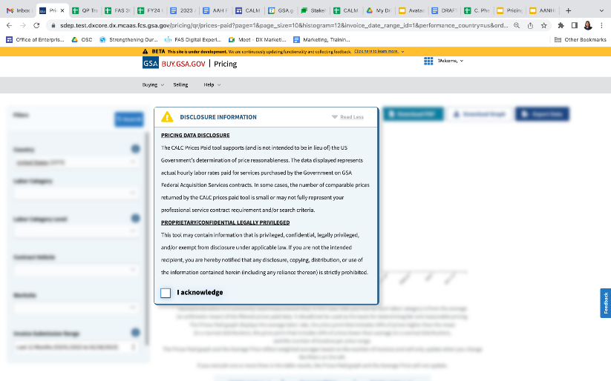
Disclosure Information
Notes:
Andrea
Prices Paid Screenshot
Disclosure information pop-up displays when you visit. Please read it, because…legal. And Policy :P:
“PRICING DATA DISCLOSURE
The CALC Prices Paid tool supports (and is not intended to be in lieu of) the US Government's determination of price reasonableness. The data displayed represents actual hourly labor rates paid for services purchased by the Government on GSA Federal Acquisition Services contracts. In some cases, the number of comparable prices returned by the CALC prices paid tool is small or may not fully represent your professional service contract requirement and/or search criteria.
PROPRIETARY/CONFIDENTIAL LEGALLY PRIVILEGED
This tool may contain information that is privileged, confidential, legally privileged, and/or exempt from disclosure under applicable law. If you are not the intended recipient, you are hereby notified that any disclosure, copying, distribution, or use of the information contained herein (including any reliance thereon) is strictly prohibited.”
Note: adding fully BLS data to this tool in the future will decrease the impact of small sample sizes that can provide inadequate pricing results.

Slide 42
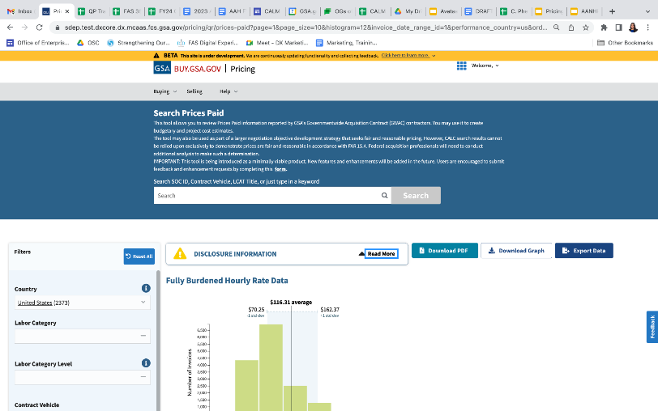
Search Prices Paid
Notes:
Andrea
Prices Paid Screenshot
Use a search term to find prices paid. You can download the data as a PDF, graph, or export the data to Excel.

Slide 43
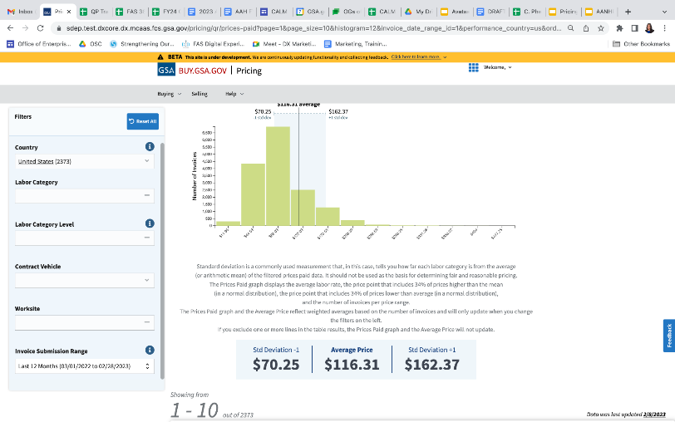
BUY.GSA.GOV - Pricing
Notes:
Andrea
Prices Paid Screenshot
You can filter by country, labor category, labor category level, contract vehicle, worksite, and invoice submission ratings. Click on each of the filter drop downs to show the various options. A bar chart appears on the right of the filters, and changes as you change the filters.

Slide 44
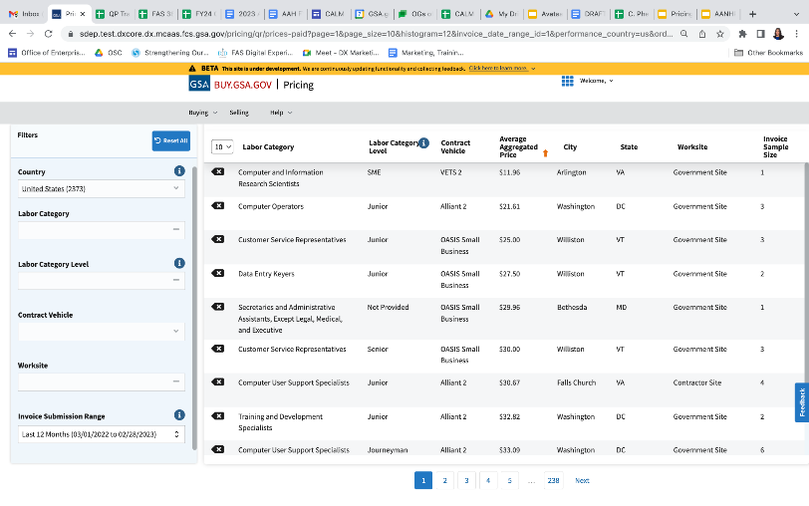
BUY.GSA.GOV Pricing
Notes:
Andrea
Prices Paid Screenshot
Labor rates and details appear to the right of the filters and below the graph. Data is displayed by labor category, labor category level, contract vehicle, average aggregated price, place of performance, and invoice sample size.
NOTE: as a minimally viable product, Prices Paid may contain duplicate pricing within the invoice samples. GSA is in the process of refining the prices paid data to only show unique records. The CALC Prices Paid tool supports (and is not intended to be in lieu of) the US Government's determination of price reasonableness. The data displayed represents actual hourly labor rates paid for services purchased by the Government on GSA Federal Acquisition Services contracts. In some cases, the number of comparable prices returned by the CALC prices paid tool is small or may not fully represent your professional service contract requirement and/or search criteria.

Slide 45
Case Study #3 Botany, Heritage, and Wildlife surveys
The scope of this contract is for the preparation of Scenery Analysis for two projects and surveys with associated reports for Heritage, Botany, and Wildlife for those two projects.
Notes:
Andrea
Case Study #3
*economic analysis includes: benefit-cost analysis, economic impact analysis, modeling and simulation, risk analysis and a quantitative policy analysis.

Slide 46
Case Study #3 Botany, Heritage, and Wildlife surveys
Labor Categories
Project Manager-BLS
Biological Scientist-BLS
Environmental Engineer-BLS
Notes:
Andrea
Case Study #3
These are the labor categories we will find rates for and where the data will come from.

Slide 47
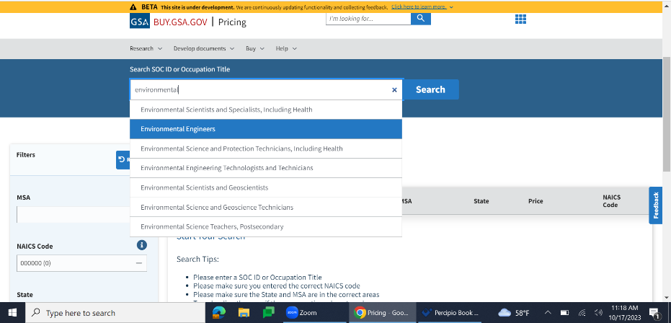
BUY.GSA.GOV Pricing Example

Slide 48
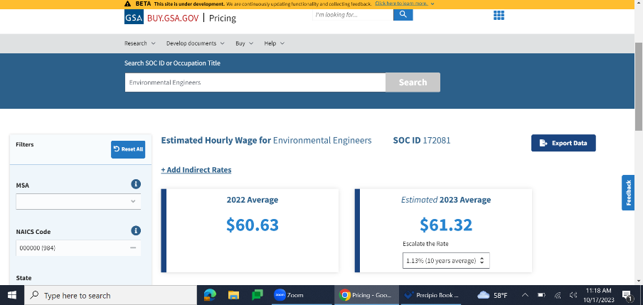
BUY.GSA.GOV Pricing Example

Slide 49
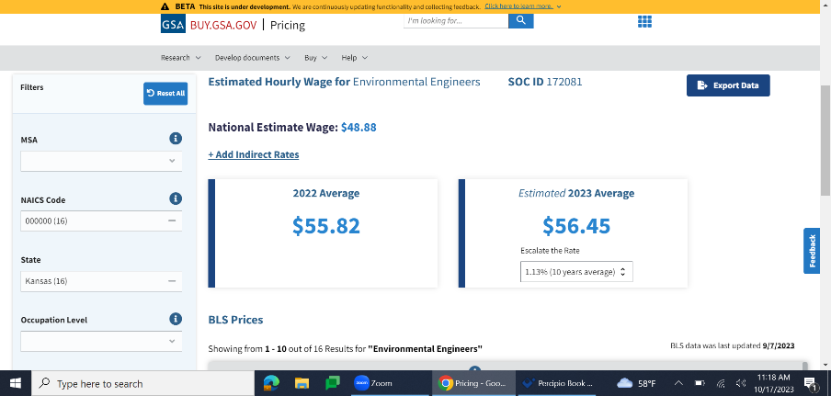
BUY.GSA.GOV Pricing Example

Slide 50
Live Demo
Notes:
Andrea
Andrea will share screen during live demo

Slide 51
Comparison of various data sources for labor rates
 | Hourly Labor Ceiling Prices | Prices Paid | Bureau of Labor Statistics | Manual Entry
Awarded rate or actual prices paid? | Awarded hourly labor rate at the master contract level | Average prices paid by the government for a labor category per hour | Estimated rates based on Department of Labor data | It depends. Find out if the labor rate you have is loaded or unloaded.
Type of rate | Ceiling rate. Do your due diligence-you should negotiate a lower rate! The worst industry can say is No. | Actual rate the government paid. You may/will pay something slightly different based on your requirement. | Estimated rates based on geographic location. You may/will pay something slightly different based on your requirement. | It depends.
Notes:
Andrea
CALC+ Quick Rate versus Prices Paid versus Manual Entry

Slide 52
Comparison of various data sources for labor rates
 | Hourly Labor Ceiling Prices | Prices Paid | Bureau of Labor Statistics | Manual Entry
Where does the data come from? | GSA Multiple Award Schedule contracts | GSA Governmentwide Acquisition Contracts (GWACs) and IT Multiple Award Contracts (MACs) | BLS Occupational Employment and Wage Statistics (OEWS) program | It depends, but mostly likely coming from another data source that isn’t GSA.
Is my labor rate loaded or unloaded? (Remember the baked potato analogy.) | Fully loaded labor rates | Fully loaded labor rates | Unloaded. You will need to load the rate yourself. The IGCE tool can help with that. | It depends. You may have to load the rate yourself. The IGCE tool can help with that.
Notes:
Andrea
CALC+ Quick Rate versus Prices Paid versus Manual Entry
GSA Professional Services MACs will be in Prices Paid in the future.

Slide 53
CALC+ Quick Rate versus Prices Paid versus
Manual Entry on the IGCE tool
 | Hourly Labor Ceiling Prices | Prices Paid | Bureau of Labor Statistics | Manual Entry
Is this data in the IGCE tool | Yes. | No. You will have to enter it yourself. | No. You will have to enter it yourself. Also, use IGCE tool to load the BLS rate to get a fully-loaded rate for your estimate. | No. You will have to enter it yourself.
Notes:
Andrea
CALC+ Quick Rate versus Prices Paid versus Manual Entry

Slide 54
Questions???

Slide 55
Resources

Slide 56
Thank You!
Office of Integrated Marketing

